Slide 1
Quick Sort

Slide 2
Quick Sort
A sorting algorithm based on the Divide and Conquer algorithm
Picks an element as a pivot and partitions the given array around the picked pivot by placing the pivot in its correct position in the sorted array.
The key function in quickSort is the partition()
The target of partitions is to place the pivot at its correct position in the sorted array and put all smaller elements to the left of the pivot, and all greater elements to the right of the pivot.

Slide 3
Quick Sort Algorithm
An array is divided into subarrays by selecting a pivot element (element selected from the array). While dividing the array, the pivot element should be positioned in such a way that elements less than pivot are kept on the left side and elements greater than pivot are on the right side of the pivot.
The left and right subarrays are also divided using the same approach. This process continues until each subarray contains a single element.
At this point, elements are already sorted. Finally, elements are combined to form a sorted array.

Slide 4
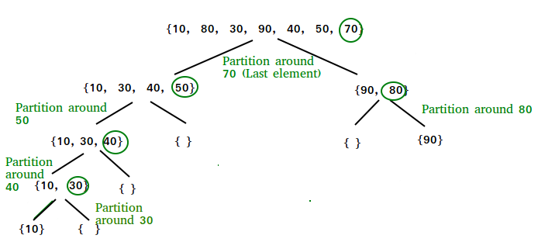
Quick Sort Algorithm
QuickSort - Data Structure and Algorithm Tutorials - GeeksforGeeks

Slide 5
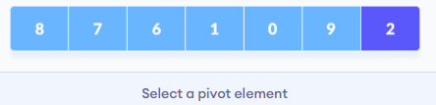
Quick Sort Algorithm
Select the Pivot Element:
There are many different choices for picking pivots.
Let’s pick the last element as a pivot.
QuickSort (With Code in Python/C++/Java/C) (programiz.com)

Slide 6
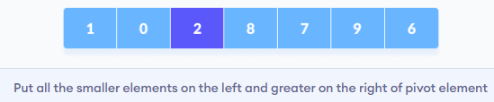
Quick Sort Algorithm
Rearrange the Array:
Elements that are smaller than the pivot are put on the left and the elements greater than the pivot are put on the right.
QuickSort (With Code in Python/C++/Java/C) (programiz.com)

Slide 7
Quick Sort Algorithm
Rearrange the Array: Let’s see how this rearrangement is done.
QuickSort (With Code in Python/C++/Java/C) (programiz.com)

Slide 8
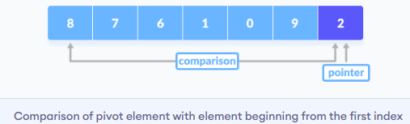
Quick Sort Algorithm
A pointer is fixed at the pivot element. The pivot element is compared with the elements beginning from the first index.
QuickSort (With Code in Python/C++/Java/C) (programiz.com)

Slide 9
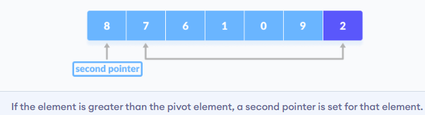
Quick Sort Algorithm
If the element is greater than the pivot element, a second pointer is set for that element.
QuickSort (With Code in Python/C++/Java/C) (programiz.com)

Slide 10
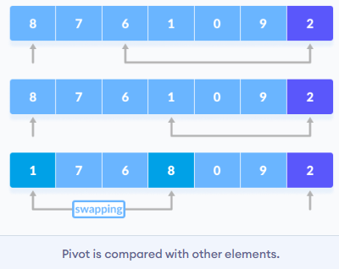
Quick Sort Algorithm
Now, pivot is compared with other elements. If an element smaller than the pivot element is reached, the smaller element is swapped with the greater element found earlier.
QuickSort (With Code in Python/C++/Java/C) (programiz.com)

Slide 11
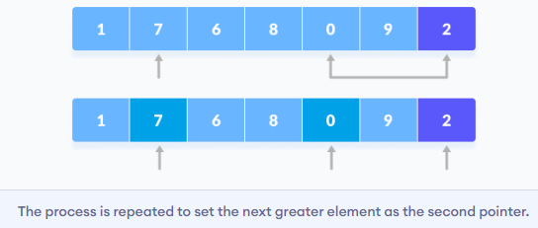
Quick Sort Algorithm
Again, the process is repeated to set the next greater element as the second pointer. And, swap it with another smaller element.
QuickSort (With Code in Python/C++/Java/C) (programiz.com)

Slide 12
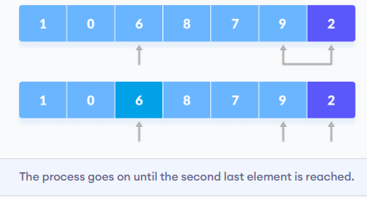
Quick Sort Algorithm
The process goes on until the second last element is reached.
QuickSort (With Code in Python/C++/Java/C) (programiz.com)

Slide 13
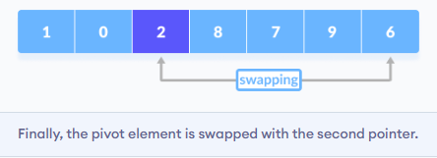
Quick Sort Algorithm
Finally, the pivot element is swapped with the second pointer.
QuickSort (With Code in Python/C++/Java/C) (programiz.com)

Slide 14
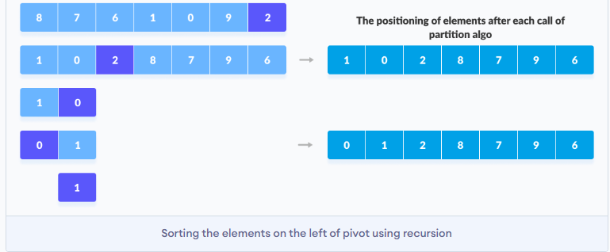
Quick Sort Algorithm
Divide Subarrays: Pivot elements are again chosen for the left and the right sub-parts separately. And, step 2 is repeated.
QuickSort (With Code in Python/C++/Java/C) (programiz.com)

Slide 15
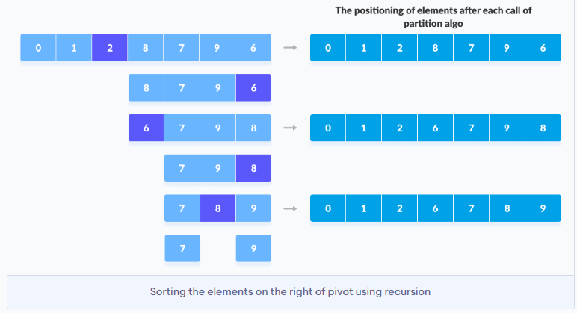
Quick Sort Algorithm
Divide Subarrays: Pivot elements are again chosen for the left and the right sub-parts separately. And, step 2 is repeated.
QuickSort (With Code in Python/C++/Java/C) (programiz.com)

Slide 16
Quick Sort Psedo-code
quickSort(array, leftmostIndex, rightmostIndex)
if (leftmostIndex < rightmostIndex)
pivotIndex <- partition(array,leftmostIndex, rightmostIndex)
quickSort(array, leftmostIndex, pivotIndex - 1)
quickSort(array, pivotIndex, rightmostIndex)
partition(array, leftmostIndex, rightmostIndex)
set rightmostIndex as pivotIndex
storeIndex <- leftmostIndex
for i <- leftmostIndex to rightmostIndex
if element[i] < pivotElement
swap element[i] and element[storeIndex]
storeIndex++
swap pivotElement and element[storeIndex]
return storeIndex
QuickSort (With Code in Python/C++/Java/C) (programiz.com)

Slide 17
Quick Sort C++ Code: quicksort() Function
void quickSort(int array[], int low, int high) {
if (low < high) {
// find the pivot element such that
// elements smaller than pivot are on left of pivot
// elements greater than pivot are on righ of pivot
int pi = partition(array, low, high);
// recursive call on the left of pivot
quickSort(array, low, pi - 1);
// recursive call on the right of pivot
quickSort(array, pi + 1, high);
}
}

Slide 18
Quick Sort C++ Code: partition() Function
// function to rearrange array (find the partition point)
int partition(int array[], int low, int high) {
// select the rightmost element as pivot
int pivot = array[high];
// pointer for greater element
int i = low;
// traverse each element of the array
// compare them with the pivot
for (int j = low; j < high; j++) {
if (array[j] <= pivot) {
// if element smaller than pivot is found
// swap it with the greater element pointed by i
// swap element at i with element at j
swap(&array[i], &array[j]);
i++;
}
}
// swap pivot with the greater element at i
swap(&array[i + 1], &array[high]);
// return the partition point
return (i + 1);
}

Slide 19
Quick Sort C++ Code: main function
// Driver code
int main() {
int data[] = {8, 7, 6, 1, 0, 9, 2};
int n = sizeof(data) / sizeof(data[0]);
cout << "Unsorted Array: \n";
printArray(data, n);
// perform quicksort on data
quickSort(data, 0, n - 1);
cout << "Sorted array in ascending order: \n";
printArray(data, n);
}

Slide 20
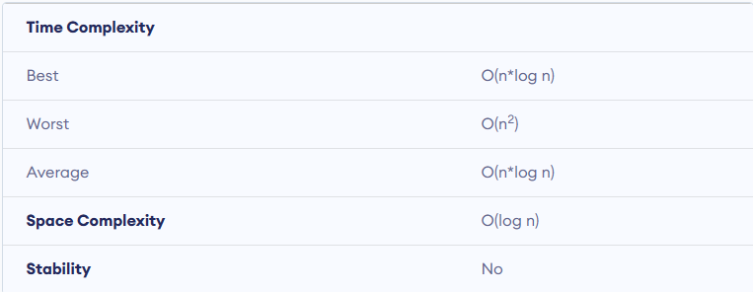
Quick Sort Complexity

Slide 21
Quick Sort Complexity
Worst Case Complexity [Big-O]: It occurs when the pivot element picked is either the greatest or the smallest element.
Best Case Complexity [Big-omega]: It occurs when the pivot element is always the middle element or near to the middle element.
Average Case Complexity [Big-theta]:

Slide 22
Space Complexity
The space complexity for quicksort is O(log n).

